Slide 1
BB2950 Day 21: Friday 12-1-17
Learning objectives:
Explain the roles of 5’ caps and how they are added.
Explain the roles of poly(A) tails and how they are added.
Explain how transcription termination occurs in eukaryotes.
Describe the consequences and significance of alternative splicing.
Explain how the spliceosome removes introns, including the roles of nucleoproteins and the roles of the 2’ and 3’ hydroxyl groups on the RNA being spliced.
Explain how RNAs are exported from the nucleus.

Slide 2
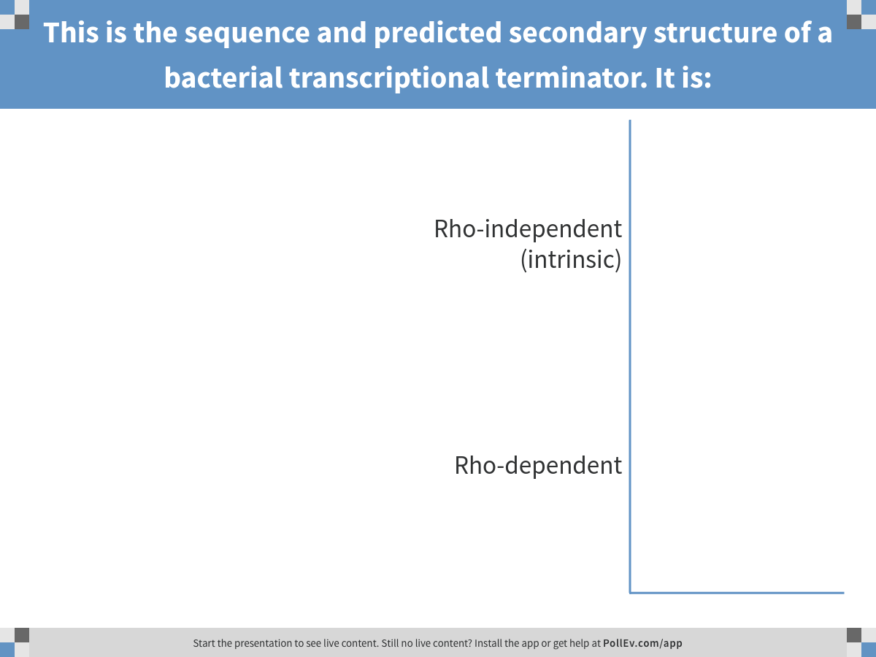
Notes:
This is the sequence and predicted secondary structure of a bacterial transcriptional terminator. It is:
https://www.polleverywhere.com/multiple_choice_polls/SyGVeHeGVxklqy3

Slide 3
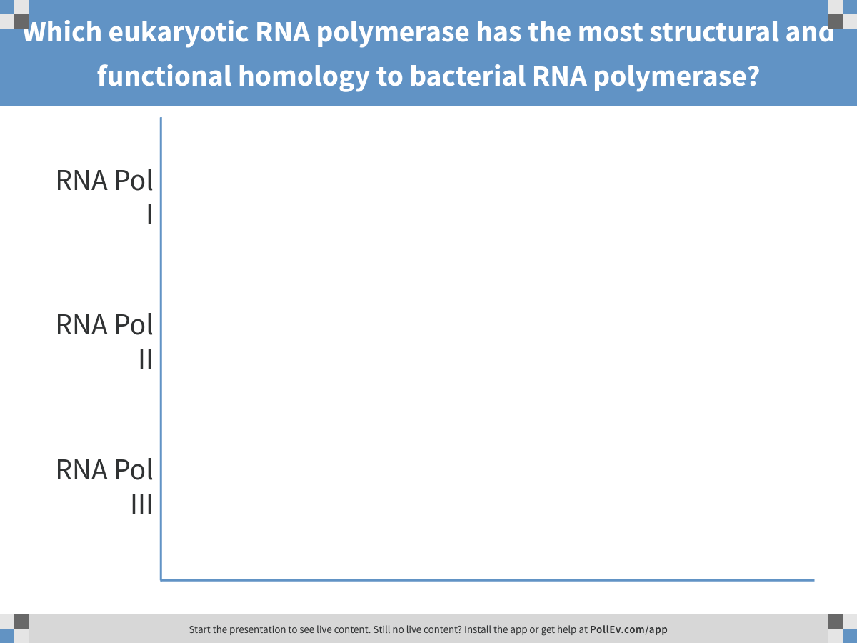
Notes:
Which eukaryotic RNA polymerase has the most structural and functional homology to bacterial RNA polymerase?
https://www.polleverywhere.com/multiple_choice_polls/Cw0SPSE6n0pprTk

Slide 4
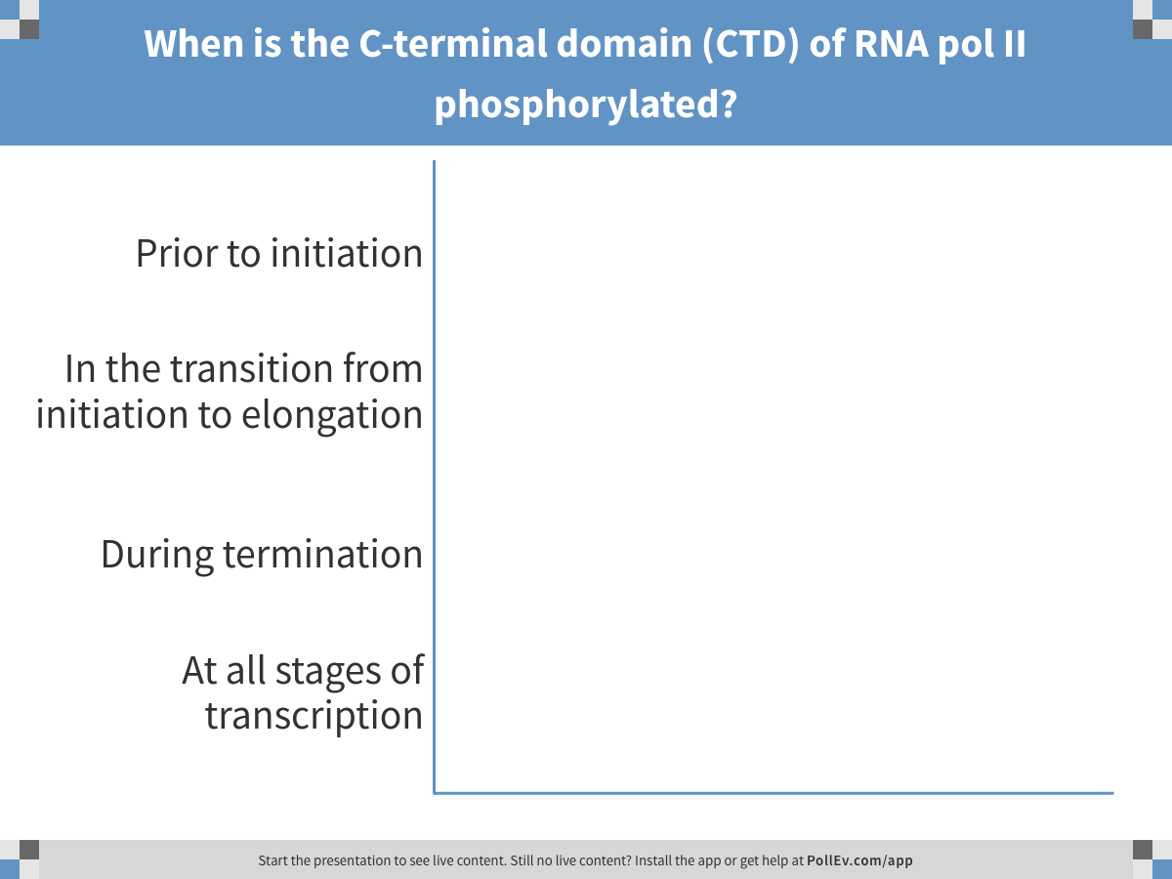
Notes:
When is the C-terminal domain (CTD) of RNA pol II phosphorylated?
https://www.polleverywhere.com/multiple_choice_polls/n35cHNibtKtZi9X

Slide 5
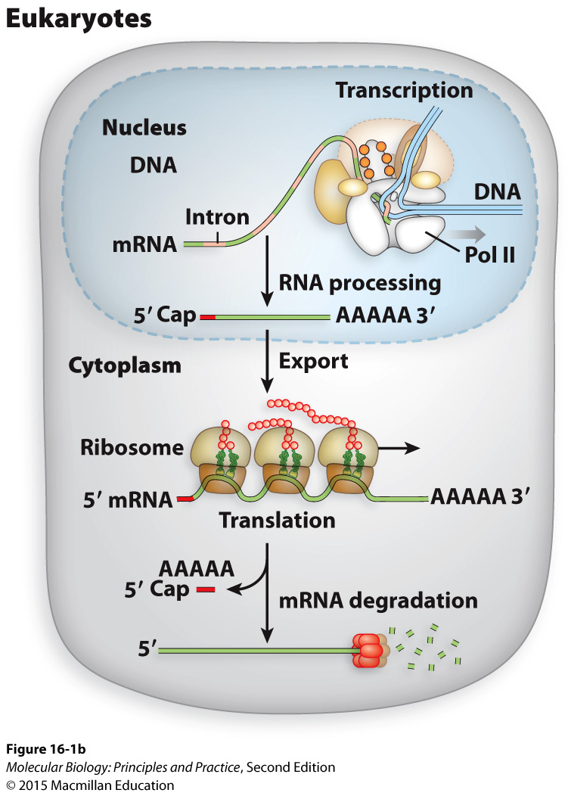
Eukaryotic pre-mRNAs must be processed before nuclear export and translation
Primary transcript ≠ mRNA
Notes:
5’ Cap
Splice out introns
Poly(A) tail

Slide 6
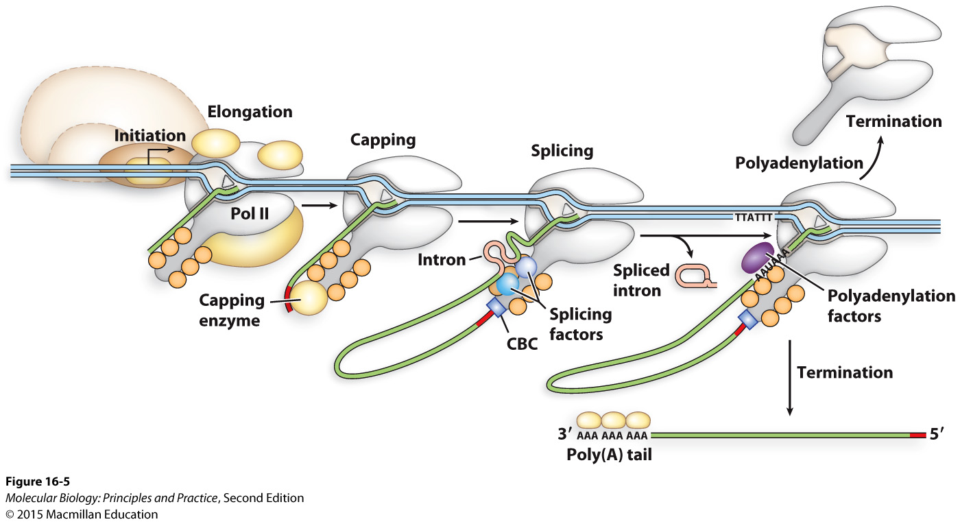
Pre-mRNA processing is coordinated with transcription

Slide 7
General roles of 5’ cap and 3’ poly(A) tails:
Prevent degradation
“Molecular handles”

Slide 8
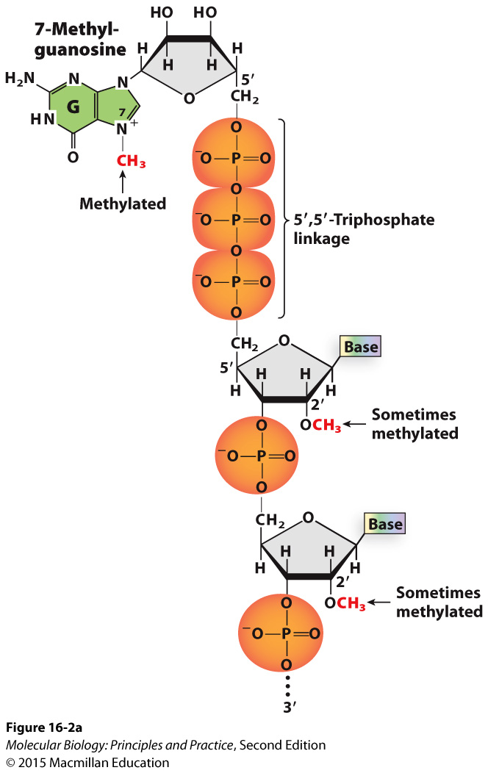
The 5’ cap is 7-methylguanosine attached by a 5’,5’ triphosphate linkage
Notes:
“Upsidedown” guanosine derivative
Roles: binding RNA Pol II via cap binding complex, protecting from degradation, binding to nuclear export proteins, recognition by ribosome.

Slide 9
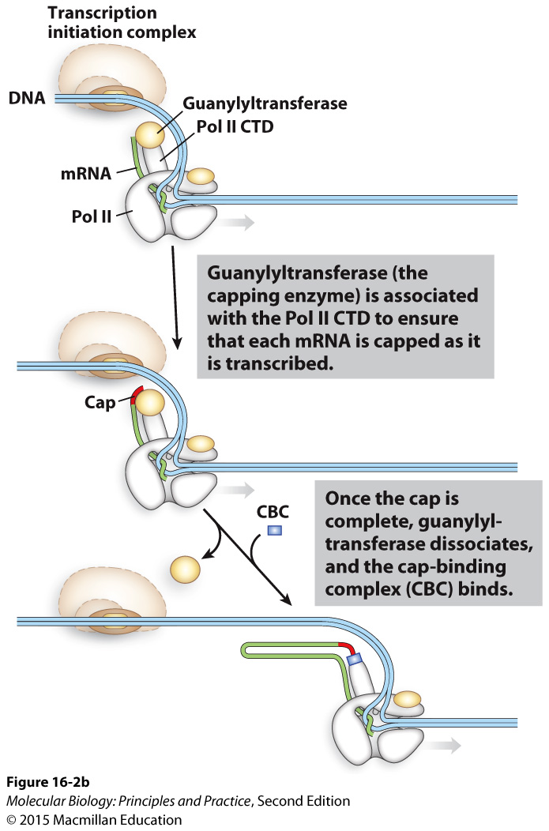
The capping enzyme binds phosphorylated RNA Pol II CTD
Cap-binding complex tethers capped transcripts to the CTD

Slide 10
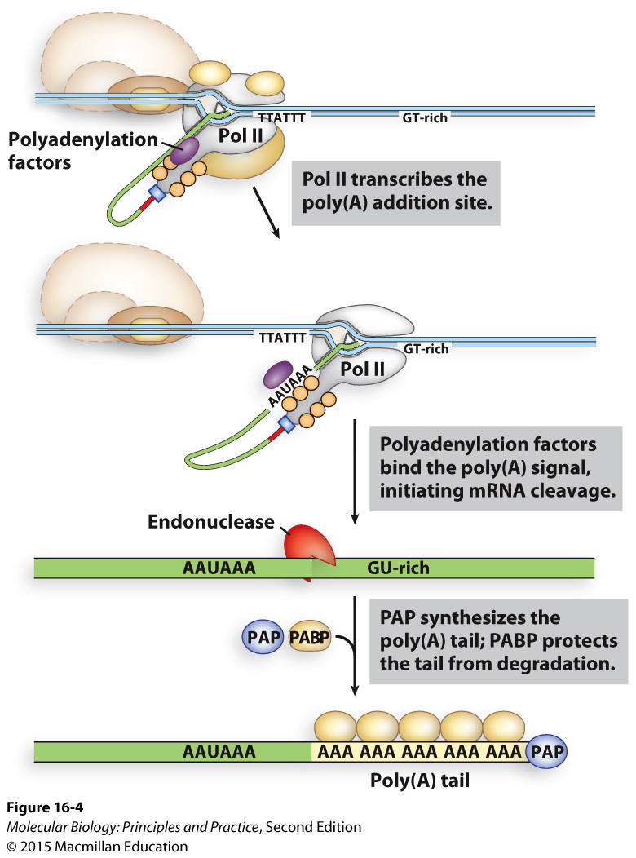
A signal sequence in the RNA is recognized by polyadenylation factors, leading to cleavage and non-templated poly(A) addition

Slide 11
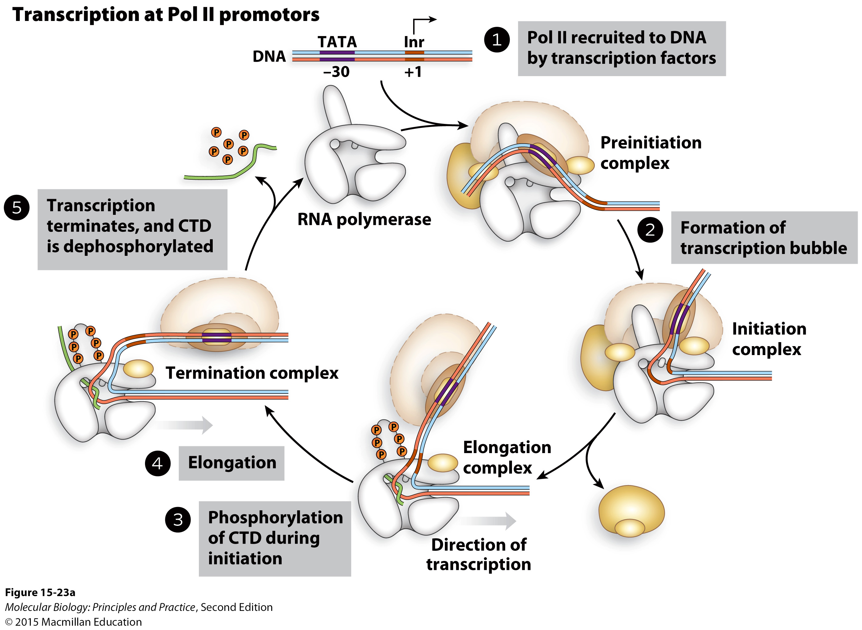
Termination of RNA Pol II transcription

Slide 12
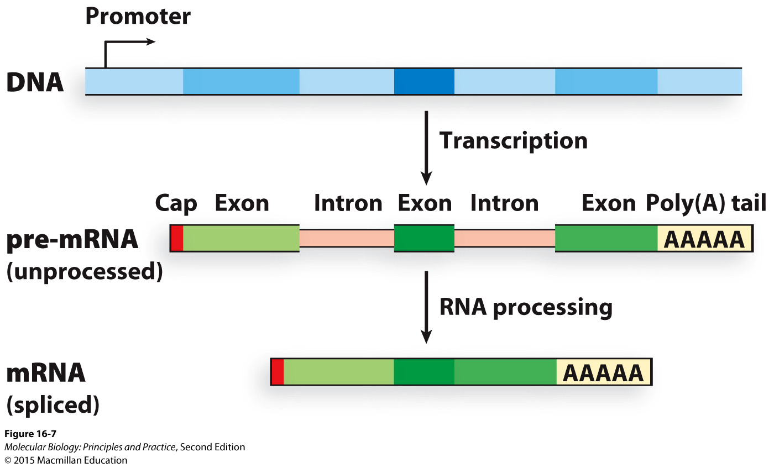
Introns interrupt the open reading frame
Mammalian genes are typically ~80-90% intron
Most genes in budding yeast have no introns

Slide 13
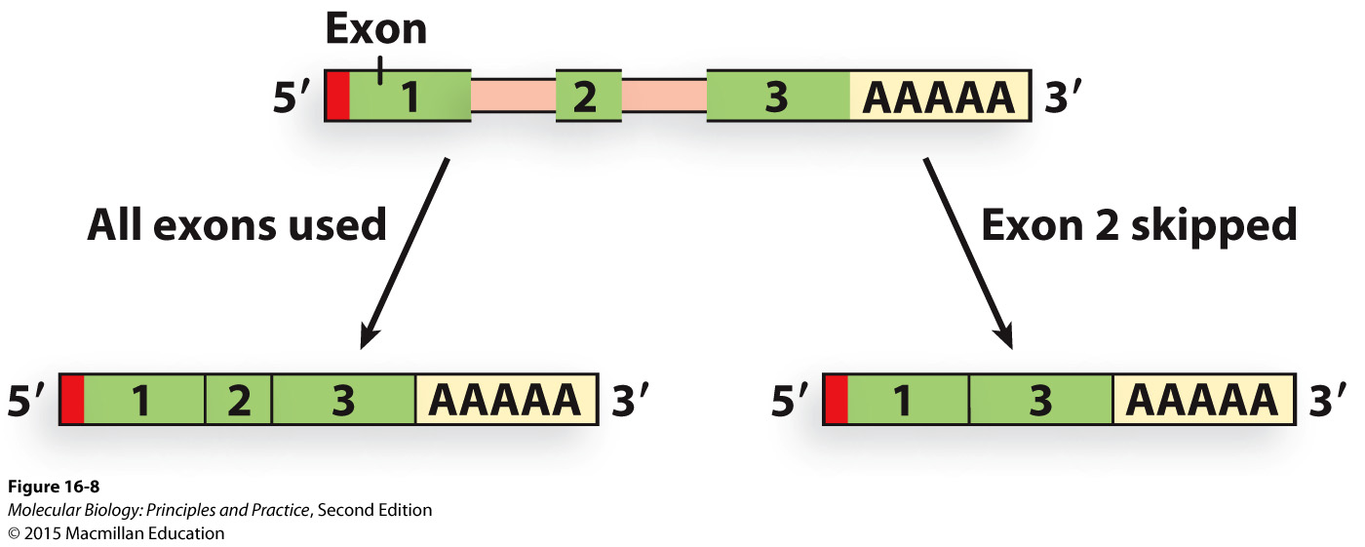
Alternative splicing allows a single gene to encode multiple distinct polypeptides

Slide 14
Alternative splicing allows a single gene to encode multiple distinct polypeptides
How would the short reads generated in RNAseq provide information on alternative splicing?

Slide 15
The spliceosome is a large protein complex responsible for splicing most eukaryotic pre-mRNAs

Slide 16
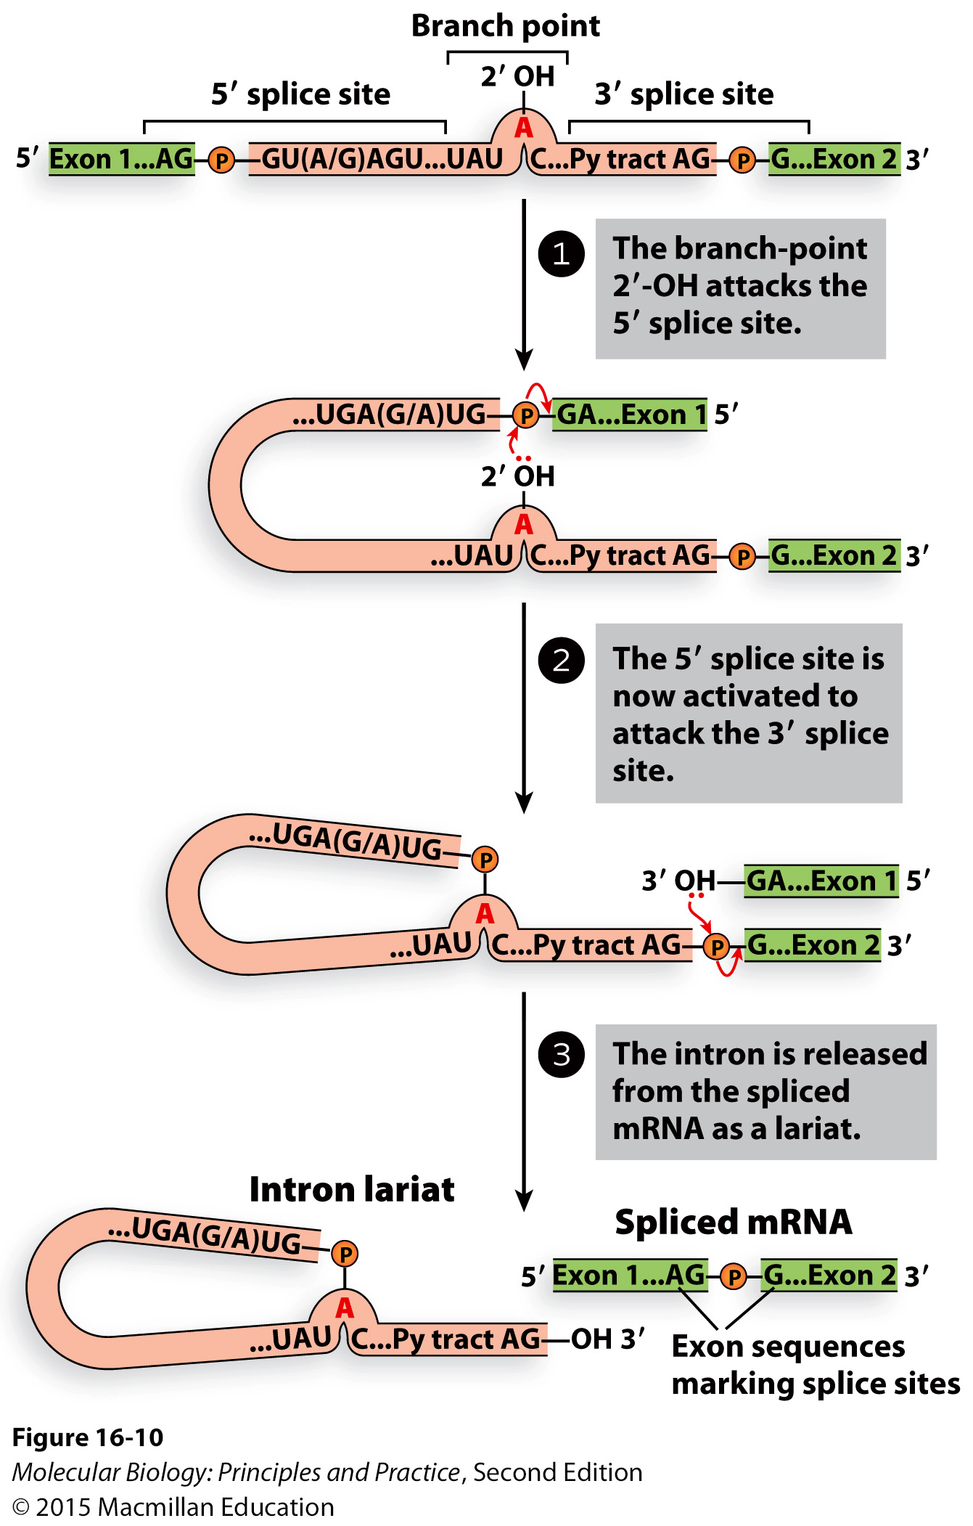
The mechanism of splicing

Slide 17
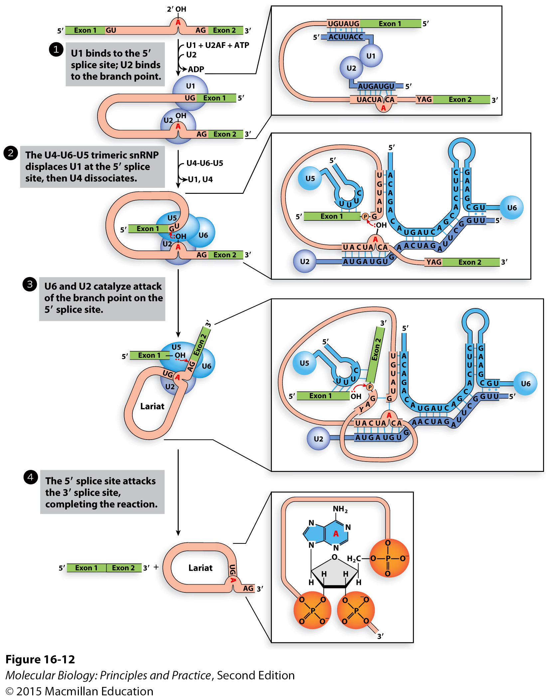
snRNPs (“snurps”) are protein-snRNA complexes that use base-pairing and other interactions to coordinate and catalyze splicing

Slide 18
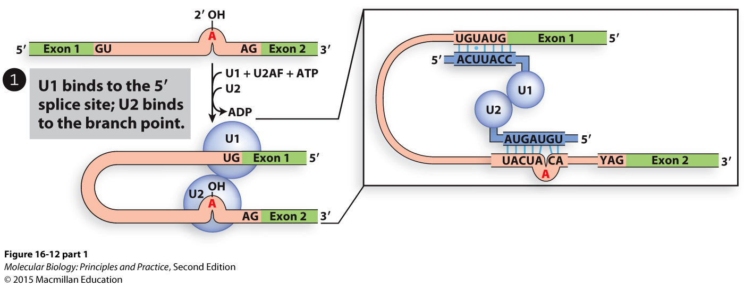
snRNPs hold pre-mRNAs in place via base-pairing between snRNA and intron

Slide 19
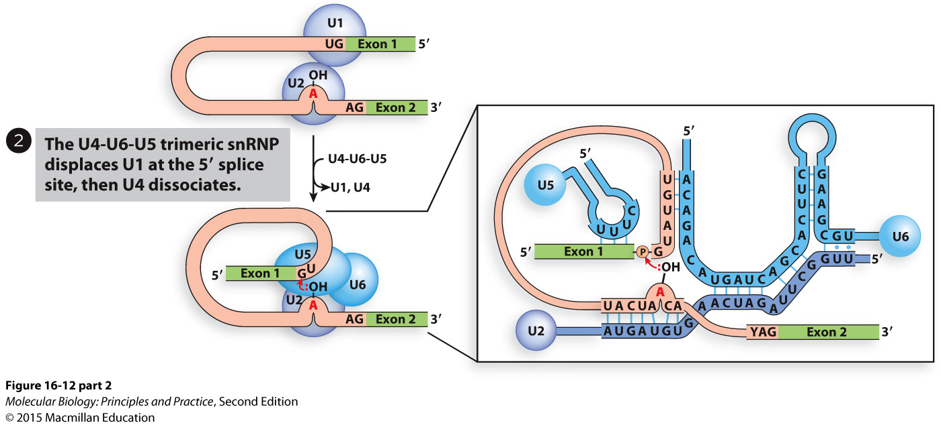
Other snRNAs base-pair with exons and with each other

Slide 20
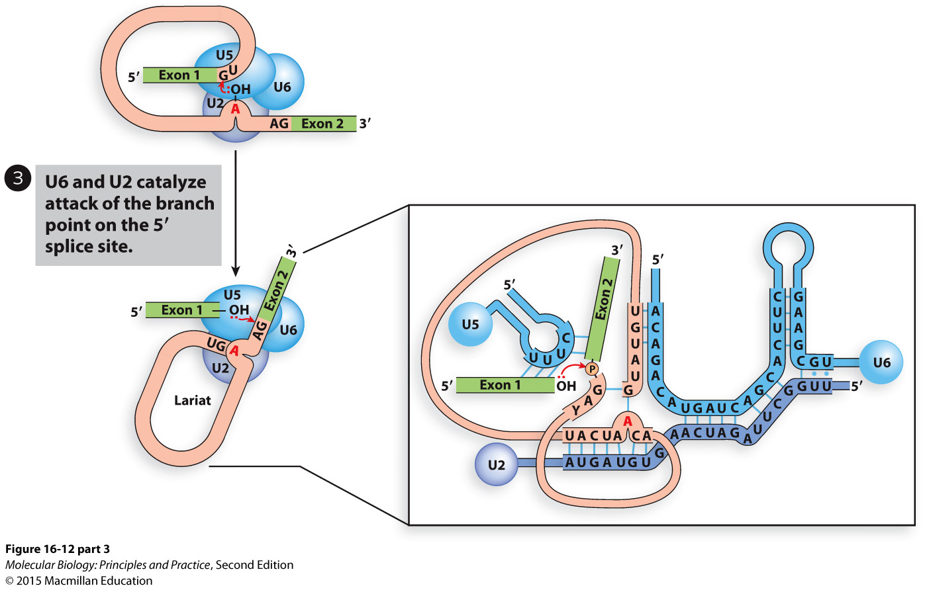
Exon 2 swings up into place so that its 5’ end is accessible to the 3’ end of exon 1

Slide 21
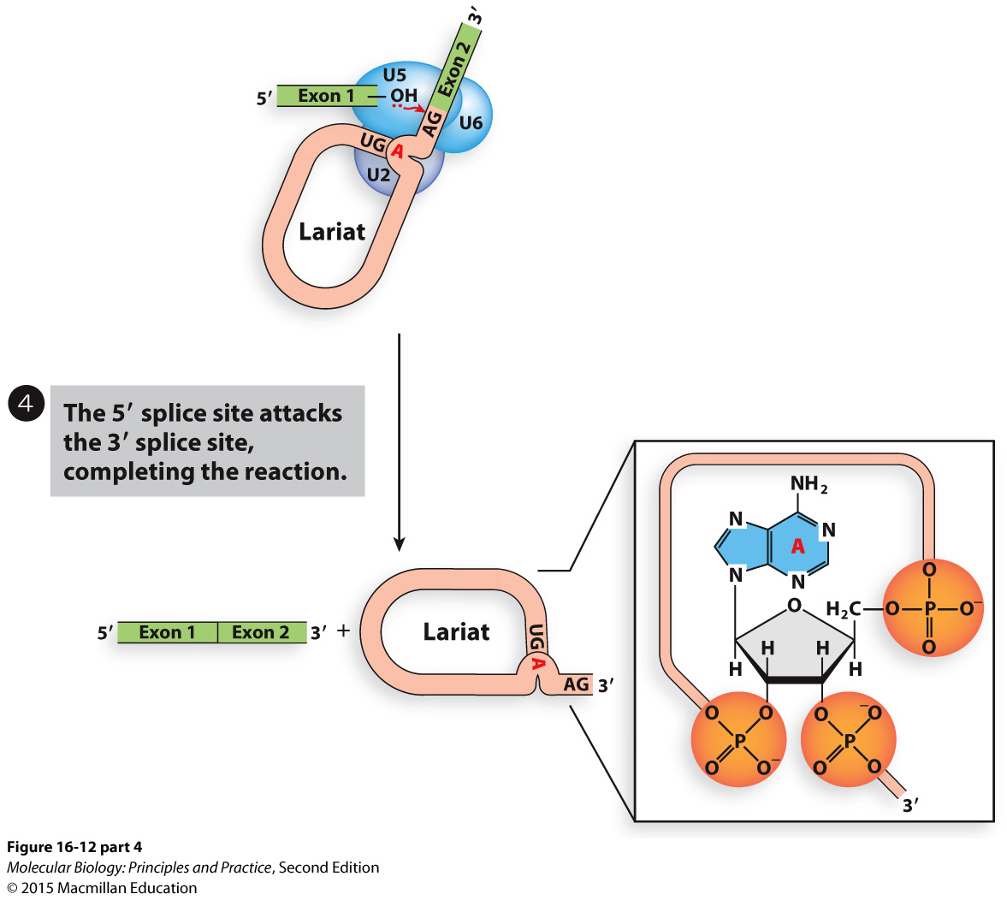

Slide 22
mRNA is exported from the nucleus into the cytoplasm by the TREX complex

